Slide 1
Responsive web design
Nada Mostafa

Slide 2
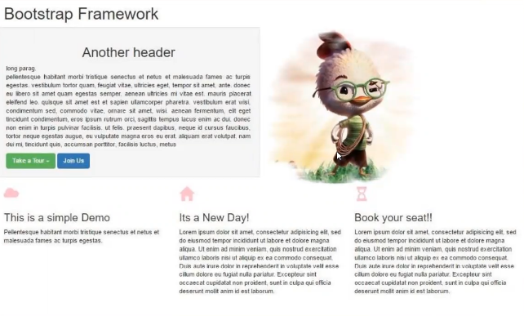

Slide 3
